Slide 1
The Controller Placement Problem
MVA 22-23: Algorithms for network optimization and management
Paul CHAUVIN

Slide 2
I. Introduction
This presentation covers clustering techniques used for controller placement optimization in SDN systems.
Four types of clustering algorithms are discussed, including P-median clustering, centered clustering, spectral clustering, and fuzzy clustering.
Technics of Reinforcement Learning to optimize the controller placement problem in SDN systems are also presented.
Ref: [2][10]

Slide 3
II. Clustering for Controller Placement
A. P-median clustering
It aims to minimize the sum of distances between each switch and its assigned controller, subject to capacity constraints.
It can be solved using
mathematical optimization techniques such as integer linear programming,
heuristics such as greedy algorithms
metaheuristic algorithms: These algorithms are based on heuristics, but they incorporate randomization and other techniques to improve their performance. Ex: The simulated annealing algorithm, which starts with an initial solution and iteratively modifies it by randomly selecting a node and moving it to a different cluster.
Matheuristics (combination of mathematical optimization and heuristics). Mathematical models to find the best solution to a problem, while heuristic methods involve using trial and error to find a solution that is close to optimal. Outperforms p-median standard clustering solving methods
It is suitable for networks with evenly distributed traffic demands and controllers with similar capacities.
It has been shown to achieve good results in terms of controller load balancing and network performance in small to medium-sized networks.
Ref: [4][6]

Slide 4
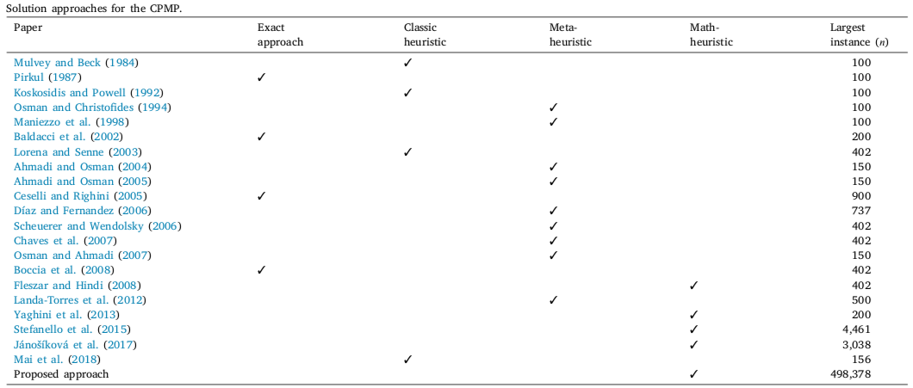
II. Clustering for Controller Placement
A. P-median clustering
Ref: [4]

Slide 5
II. Clustering for Controller Placement
B. Centered clustering
It aims to minimize the maximum distance between any switch and its assigned controller, subject to capacity constraints.
It can be solved using heuristics. Once again, matheuristics outperforms standard centered clustering for large scale problems.
It is suitable for networks with unevenly distributed traffic demands and controllers with different capacities.
It has been shown to achieve good results in terms of minimizing controller load and reducing network latency in large-scale networks.
Ref: [4][5][9]

Slide 6
II. Clustering for Controller Placement
C. Fuzzy clustering
It is a clustering technique that assigns each data point a degree of membership in each cluster, rather than a hard assignment to a single cluster. This allows for more flexible and nuanced clustering decisions.
It can be customized to incorporate various metrics and constraints, such as network latency, load balancing, and energy consumption, in the controller placement optimization problem.
It has been shown to outperform traditional clustering methods, such as k-means and p-median clustering, in terms of network performance metrics.
It can be used in conjunction with other optimization techniques.
Ref: [3]

Slide 7
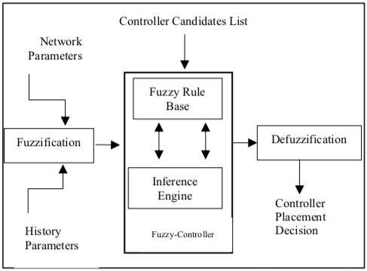
II. Clustering for Controller Placement
C. Fuzzy clustering
Ref: [3]

Slide 8
II. Clustering for Controller Placement
D. Spectral clustering
It is a graph-based clustering method that uses the eigenvectors of a graph's Laplacian matrix to partition the graph into clusters.
In SDN, spectral clustering is used to partition the network topology into clusters and select the optimal locations for SDN controllers, with the goal of optimizing network performance metrics.
It can be used in conjunction with other optimization techniques.
It can be customized to incorporate various factors, such as traffic demand, link capacities, and controller capacity constraints, in the controller placement optimization problem.
It has been shown to outperform traditional methods for SDN controller placement, such as k-means clustering and random placement, in terms of network performance metrics.
Ref: [7][8]

Slide 9
II. Clustering for Controller Placement
E. Comparison between Fuzzy and Spectral clustering
Flexibility: Fuzzy clustering is more flexible than spectral clustering, as it allows for overlapping clusters and allows data points to belong to multiple clusters with different degrees of membership. Spectral clustering is more rigid, as it requires a predefined number of clusters and assigns each data point to only one cluster.
Algorithm: Fuzzy clustering is based on iterative algorithms that minimize a cost function, while spectral clustering is based on linear algebra techniques that compute the eigenvectors of a graph Laplacian matrix.
Performance: Fuzzy clustering is generally faster and more computationally efficient than spectral clustering, especially for large datasets. However, spectral clustering has been shown to perform better than fuzzy clustering in some cases, particularly when the data has a clear geometric structure.
Ref: [3][7][8]

Slide 10
III. Deep Reinforcement Learning for controller placement in SDN
Deep Reinforcement Learning (DRL) is used to explore the solution space and improve the controller placement problem's efficiency in SDN systems. It integrates historical network data learning into the controller deployment and real-time switch-controller mapping decision.
The Multi-Armed Cooperative Synchronization (MACS) policy, developed using reinforcement learning techniques combined with deep neural networks, shows a significant performance improvement (56% and 30%) over ONOS and greedy SDN controller synchronization heuristics.
Deep Q-Network (DQN) empowered Dynamic flow Data Driven approach for Controller Placement Problem (D4CPP) considers flow fluctuations, data latency, and load balance. D4CPP is adaptable to the dynamic network environment with flow fluctuations. Simulations show that D4CPP outperforms standard approaches by 13% in latency and 50% in load balance on average when the latency and load balance are equally weighted in SDN systems.
Ref: [1][11]

Slide 11
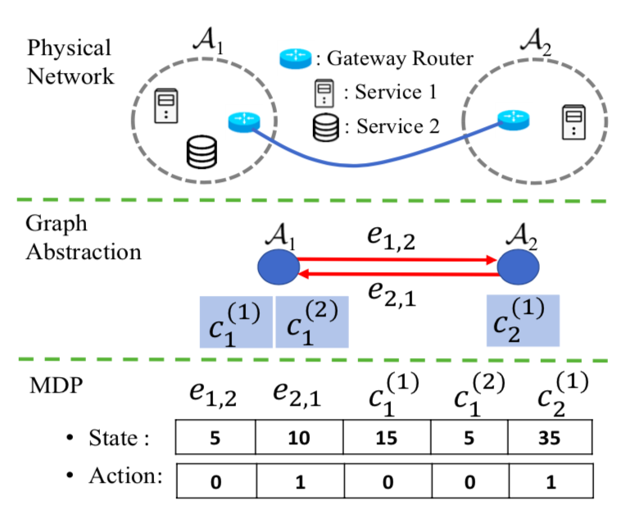
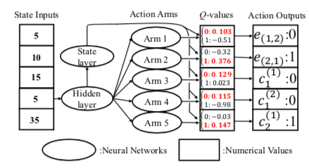
III. Deep Reinforcement Learning for controller placement in SDN
MACS architecture
Ref: [1][11]

Slide 12
IV. Conclusion
Clustering algorithms are powerful tools for optimizing controller placement in SDN systems, and the four types discussed in this presentation offer different strengths for different network scenarios.
Spectral clustering and fuzzy clustering are particularly effective at optimizing network performance metrics such as latency and load balance.
The proposed D4CPP approach, which uses DRL to optimize controller placement in SDN systems, outperforms standard algorithms in terms of latency and load balance.
D4CPP is an example of how machine learning and optimization techniques can be used together to provide flexible and adaptable control and management of SDN networks.
The effectiveness of clustering algorithms and the RL approach highlights the importance of using data-driven approaches to optimize network performance.
As SDN systems continue to grow in size and complexity, clustering algorithms and machine learning techniques will play an increasingly important role in ensuring optimal network performance and scalability.

Slide 13
Thank you !

Slide 14
References
[1] Yiwen Wu, Sipei Zhou, Yunkai Wei, and Supeng Leng. Deep reinforcement learning for controller placement in software defined network. In IEEE INFOCOM 2020 - IEEE Conference on Computer Communications Workshops (INFOCOM WKSHPS), pages 1254–1259, 2020.4
[2] Brandon Heller, Rob Sherwood, and Nick McKeown. The controller placement problem. In Proceedings of the first workshop on Hot topics in software defined networks. ACM, August 2012.
[3] S. Sohail and A. Khanum, "Fuzzy Approach to Controller Placement Problem: Fuzzy Controller (FC)," 2018 International Conference on Advances in Big Data, Computing and Data Communication Systems (icABCD), Durban, South Africa, 2018, pp. 1-5, doi: 10.1109/ICABCD.2018.8465134.
[4] Mario Gnägi and Philipp Baumann. A matheuristic for large-scale capacitated clustering. Computers&amp Operations Research, 132:105304, August 2021.
[5] Jianxin Liao, Haifeng Sun, Jingyu Wang, Qi Qi, Kai Li, and Tonghong Li. Density cluster based approach for controller placement problem in large-scale software defined networkings. Computer Networks, 112:24–35, January 2017.
[6] Jack Brimberg and Zvi Drezner. Solving multiple facilities location problems with separated clusters. Operations Research Letters, 47(5):386–390, September 2019.
[7] Peng Xiao, Wenyu Qu, Heng Qi, Zhiyang Li, and Yujie Xu. The sdn controller placement problem for wan. In 2014 IEEE/CIC International Conference on Communications in China (ICCC), pages 220–224, 2014.
[8] Jie Lu, Zhang Zhen, and Tao Hu. Spectral clustering based approach for controller placement problem in software defined networking. Journal of Physics: Conference Series, 1087:042073, September 2018.
[9] H. Kuang, Y. Qiu, R. Li and X. Liu, "A Hierarchical K-Means Algorithm for Controller Placement in SDN-Based WAN Architecture," 2018 10th International Conference on Measuring Technology and Mechatronics Automation (ICMTMA), Changsha, China, 2018, pp. 263-267, doi: 10.1109/ICMTMA.2018.00070.
[10] Md. Tanvir Ishtaique ul Huque, Guillaume Jourjon, and Vincent Gramoli. Revisiting the controller placement problem. In 2015 IEEE 40th Conference on Local Computer Networks (LCN), pages 450–453, 2015
[11] Ziyao Zhang, Liang Ma, Konstantinos Poularakis, Kin K. Leung, Jeremy Tucker, and Ananthram Swami. Macs: Deep reinforcement learning based sdn controller synchronization policy design, 2019

